Slide 1
Adaptive Learning Rate for Federated Learning in Resource Constrained Devices
By: Vipul Singh Negi
Notes:
Be specific and direct in the title. Use the subtitle to give the specific context of the speech.
-The goal should be to capture the audience’s attention which can be done with a quote, a startling statistic, or fact. It is not necessary to include this attention getter on the slide.

Slide 2
Content
Introduction.
Types of Federated Learning.
Things required for Communication-Efficient Learning.
Creating a client selection strategy focusing on adaptive learning rate.
Notes:
Use the background points to post details that are not common knowledge, or that the audience will need to understand the context of the speech.
-Do not read these main points from the PowerPoint, instead elaborate on these points during the speech.

Slide 3
Federated Learning
“Federated Learning is born at the intersection of edge computing/IoT, on-device AI, and blockchain”.
Under federated learning, multiple people remotely share their data to collaboratively train a single deep learning model, improving on it iteratively, like a team presentation or report. Each party downloads the model from a data center in the cloud, usually a pre-trained foundation model. They train it on their private data, then summarize and encrypt the model’s new configuration. The model updates are sent back to the cloud, decrypted, averaged, and integrated into the centralized model. Iteration after iteration, the collaborative training continues until the model is fully trained.
Notes:
Dedicate this entire slide to the thesis statement. It is the reason the speech is being given. Use this time to reveal the three main points of the speech (slides 4,5,6) as an overview for the direction of the speech:
-[type main point #1 here]
-[type main point #2 here]
-[type main point #3 here]
Be sure to transition to the first main point and the next slide.

Slide 4
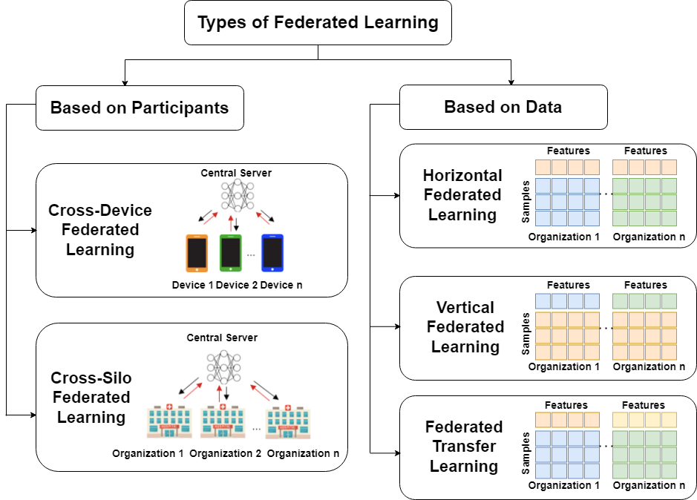
Types of Federated Learning
Notes:
The title of main point #1 should be clear and concise. Each piece of evidence should be summarized for clarity and cited correctly. Do not simply read the pieces of evidence, but elaborate where needed.
[type notes for elaboration here]
Be sure to transition to main point #2 and the next slide.

Slide 5
Contd.
The focus of our work lies in the Participation based FL using Cross-Device FL.
The type of Data used for the work is Independent and Identically Distributed (IID).

Slide 6
Things required for Communication-Efficient Learning
There are mainly 3 ways to achieve this:
Local Updating of Model: To use more local epoch instead of communication rounds. Since adding more communication round leads to slower systems.
Model Compression Scheme: To reduce the overall size of the DL Model (MobileNets, LeNets etc.)
Decentralized Training: To operate in low bandwidth.

Slide 7
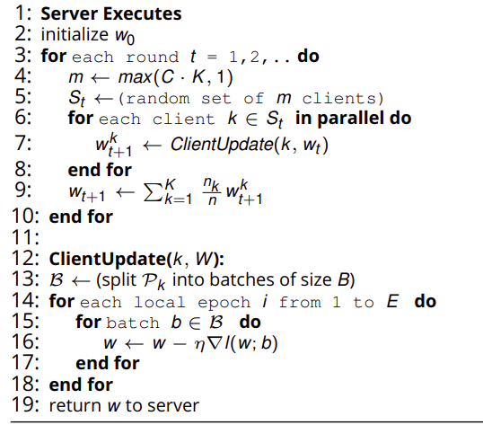
SDG in FedAvg
Step number 16 in the FedAvg Strategy is called SGD in which η is know as the learning rate.

Slide 8
Creating a client selection strategy focusing on adaptive learning rate.
Firstly we need for find out the time taken to run a single local epoch. In order to do that we need to perform a matrix multiplication of two big tensors. That will figure out the performance of the system. Lets call this term as t_{c}.
The next parameter we need is the Global Epoch (E).
We first get the Average Time of Computation and Mode Value of the Computational time.
If Mode < Avg t:
config = E and lr = 0.0001
Else If t_{c} < Avg t:
config = (Total Evaluation Clients/ Total Available Clients)*E and lr = 10* old_lr
Else:
config = E/2 and lr = 10*10*old_lr

Slide 9
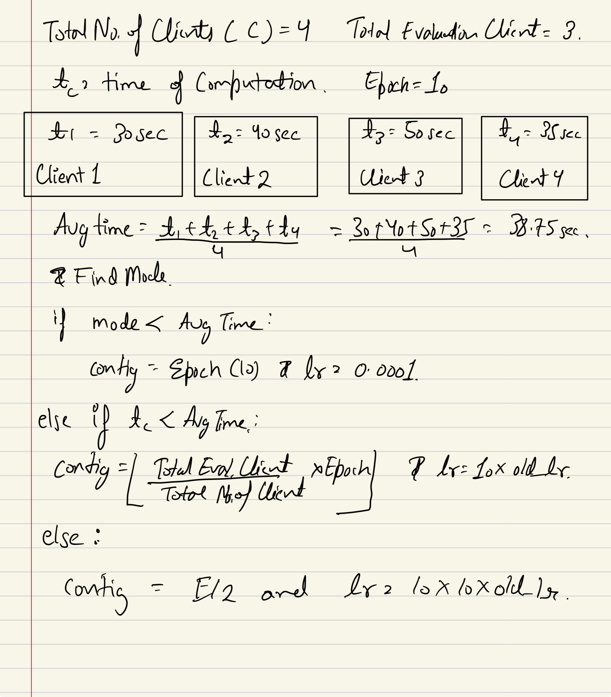
Contd.

Slide 10
Contd.
This methodology will significantly reduce the number of slacker participants due to the following reasons:
We have selected mode value for comparison because if will either group the best devices together or the slackers.
The slowest devices will have a higher t_{c} and to tackle that we have reduced the total number of epochs for those clients.
The learning rate is increased by the multiple of 10 adjusted for the slower devices to work on a tighter learning rate so that faster devices are not made into the new slackers.

Slide 11
Thank You

